Slide 1
Identifying Actors
Actors are anything that interfaces with the system.
Examples: people, software, hardware, other systems.
Each actor defines a particular role
Actors are always external to your system
RE-2 <number>

Slide 2
Identifying Actors
Each entity outside the system may be represented by 1 or more actors
1 physical person - several actors (several roles)
or
several persons - one actor (one role)
Example:
Mary : customer + employee
Mary + Bill : customer
RE-2 <number>

Slide 3
Identifying Actors
Questions for Identifying actors :
  Who uses the system?
  Who installs the system?
  Who starts up the system?
  Who maintains the system?
  Who shuts down the system?
  What other systems use this system?
  Who gets the information from this system?
  Who provides information to the system?
  Does anything happen automatically at a present time?
RE-2 <number>

Slide 4
Identifying use cases
Use cases describe the system functionalities
The name of the use case states the user task in the form “verb + object”
A use case is always started by an actor, unless it is triggered by a change in the system’s state
A use case is not a single scenario
Go through all of the actors and identify use cases for each one
RE-2 <number>

Slide 5
Identifying use cases (cont.)
Examples:
  What functionalities will the actor want from the system
  Create, read, update, delete information that the system stores
  Actor notification when system’s internal state is changing
  System notification about external events
  Diagnostics
  Installation, training, maintenance
  Changing a business process
RE-2 <number>

Slide 6
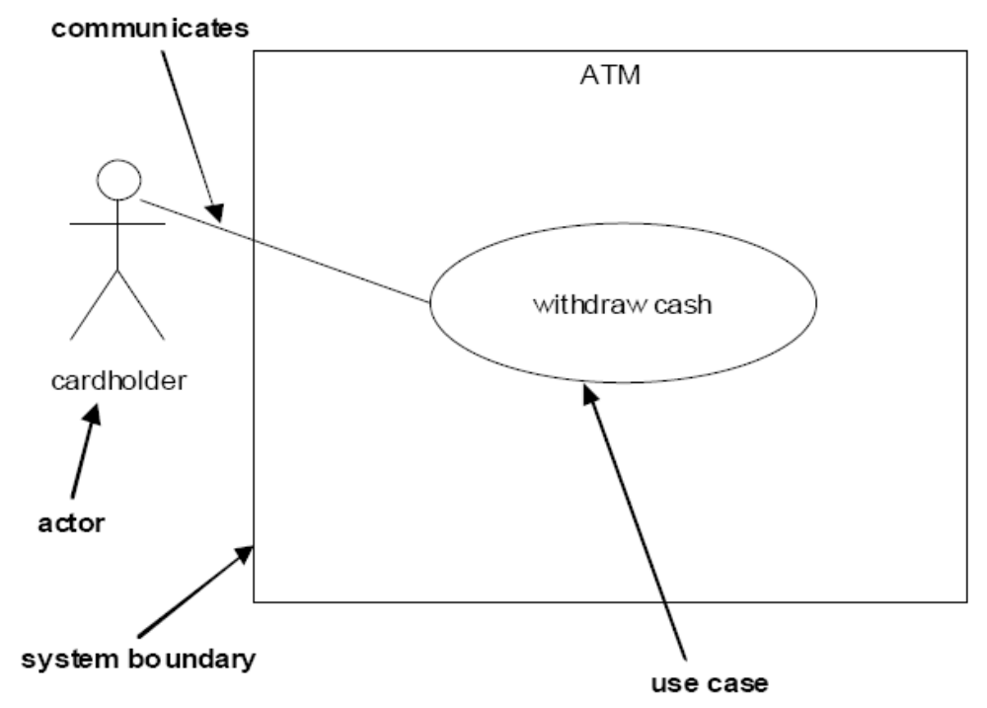
Use case diagram
RE-2 <number>

Slide 7
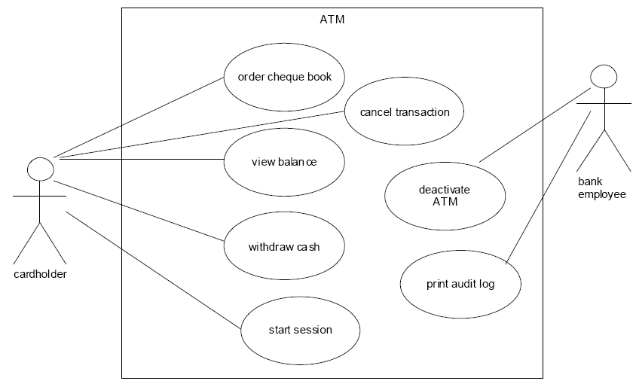
Use case diagram
RE-2 <number>

Slide 8
Assignment 4
Identify the use cases for the mail order system.
Draw the use case diagram
Find the boundaries of the system:
  what things are inside your system (you need to create them) and
  what things are outside your system (you don’t need to create them, but you need to interface with them)
RE-2 <number>

Slide 9
Use cases - Internal structure
Precondition
Flow of events
  basic path
  alternative paths
Post condition
  must be true no matter which branch or alternative is followed for the use case
Special requirements
RE-2 <number>

Slide 10
Use Case Example
Withdraw Money Use Case
Introduction
Withdraw Money lets a bank Customer withdraw money from an ATM.
Precondition: A valid Customer is identified.
Flow of Events:
  1. The use case starts when the Customer selects Withdraw Money.
  2. The Customer chooses how much to withdraw and from which account.
  3. The system responds with how much can be withdrawn from that account.
  4. The system dispenses the amount.
  5. The system deducts the amount from the account and the use case ends.
RE-2 <number>

Slide 11
Use Case Example
Alternative Paths:
In step 5, if the deduction results in an overdraft, it is handled accordingly to {Account Overdrawn}.
Postcondition: The transaction has been recorded in the system.
Special requirements:
The following are maximum response times as the system:
  verifies the identity of the Bank Customer
  presents the balance of Account that the Bank Customer has chosen
  dispenses the amount and deducts the amount from the Account.
Whenever the server does not respond within 5 seconds, the client considers the server to be down and cancels the use case.
There may be no more than 100 instances of the use case Withdraw Money executing in parallel on this server.
RE-2 <number>

Slide 12
Flow of events
Alternative paths stated either
  as if statement in the basic path or
  in the alternative paths section
Use explicit repetition constructs for and while to repeat a step or multiple steps
RE-2 <number>

Slide 13
Primary scenarios
Written as if everything goes right: no errors, no branching or alternatives
Written from the actor’s point of view
Start by indicating who begins the scenario and how
Continue listing steps
Finish by indicating how the scenario ends
Update the list of actors and use cases
RE-2 <number>

Slide 14
Primary scenarios (cont.)
The steps will be ordered by time
If the steps can run concurrently, make it clear in the beginning of the scenario
NFRs
  can be included either in a “Special Requirements” section of the use case
  OR
  in an “Other requirements” document
RE-2 <number>

Slide 15
Primary scenarios (cont.)
Presentation styles:
  informal
  numbered sequence of steps
  Pseudocode
  - UML activity diagrams
RE-2 <number>

Slide 16
Informal Text Form of Use Case
Cancel Order use case
When the customer rep receives a request to cancel an order, the customer rep finds the order in the system and marks it canceled. Then a request is sent to the accounting system to credit the customer’s account.
RE-2 <number>

Slide 17
Numbered Sequence of Steps
Cancel Order use case
1. The use case begins when the customer rep receives a request to cancel an order.
2. The customer rep enters an order ID.
3. The customer rep presses “Find” to find the order in the system.
4. The system will display that order.
5. The system marks the order canceled.
6. The accounting system is notified to credit the customer’s account and the use case ends.
RE-2 <number>

Slide 18
Pseudocode Form of Use Case
Cancel Order use case
Order = Customer.CancelOrder (OrderNumber)
Order. Status = canceled
Accounting.SendRefund (Customer, Order. Amount)
RE-2 <number>

Slide 19
Activity Diagram Example – Place Order Use case
Log In
Submit
[Place order selected]
[info complete]
Order Form
Displayed
Order Marked
Pending
Enter Name
and Address
Payment Information
Sent to Accounting
[Product code entered]
[payment good]
Product Description
and Price Displayed
Order Marked
Confirmed
[product code
entered]
New Total
Calculated
Order ID
Displayed
[No more product codes]
Enter Credit
Card Information
RE-2 <number>

Slide 20
Secondary Scenarios
Alternative scenarios
Exception scenarios
Documentation styles:
  include the alternative/exceptions in either of these choices:
    the basic path of a primary scenario
    the alternative path section
    separate secondary scenarios
RE-2 <number>

Slide 21
Scenarios
  Describe one path through the use case (an instance)
  Example:
    an order that is complete, with the correct payment arrives
    an order that is missing a payment arrives
  Primary scenarios - the basic use case functionality
  Secondary scenarios - alternatives + error conditions
RE-2 <number>

Slide 22
Exercises
Class exercise: Write a primary and a secondary scenario for the mail order system
Group exercise: write a primary and a secondary scenario for the automated library system.
RE-2 <number>

Slide 23
Generalization mechanisms
<<Extends>>
[amount to be withdrawn > balance]
Extends
Includes
Inheritance between actors, use cases
Interfaces for actors, use cases
Withdraw
Money
Overdraft
Management
Withdraw
Money
Deposit
Money
Transfer Between
Accounts
<<includes>>
Validate User
RE-2 <number>

Slide 24
Extends Relationships
Useful for changes and additions to an existing use case
When you have an optional sequence of events you want to add to a use case – for customizing a product, or when working on a later version of an existing product
Start by determining what you want to add and where in the use case that needs to be modified
The use case being extended does not change
Update the use case diagram to include extension points, and the conditional expression that would trigger the extending use case
Write a use case describing what will happen at the extension point (the extending use case)
RE-2 <number>

Slide 25
Extends Relationships
Can have more extensions from one point. The order of execution is undefined.
Exercise: Write an extending use case for the Place Order Use Case. The extending use case should calculate the product price when a product is on sale.
RE-2 <number>

Slide 26
Place Order Use Case
The use case begins when the customer selects Place Order
The customer enters his or her name and address
If the customer enters only the zip code, the system supplies the city and state.
The customer enters product codes for products to be ordered.
For each product code entered
  The system supplies a product description
  The system supplies a product price
  The system adds the price of the item to the total
end loop
The customer enters credit card payment information
The customer selects Submit
The system verifies the information, saves the order as pending, and forwards payment information to the accounting system.
When payment is confirmed, the order is marked confirmed, an order ID is returned to the customer, and the use case ends.
RE-2 <number>

Slide 27
Includes Relationships
Abstracts the common behavior from several use cases
The common behavior is introduced by the Include keyword
Can have as many levels of include as you need
No limit on the number of use cases that can be “included”
Exercise: Cancel Order includes Search Order
RE-2 <number>

Slide 28
Inheritance Relationships
Between actors or between use cases
Inheritance between Actors:
  An actor fills the same roles as another actor, and some other additional roles
  It interacts with the same use cases in the same way, therefore we can simplify the use case diagram by using this inheritance relationship
RE-2 <number>

Slide 29
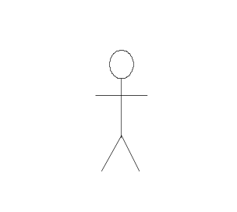
Inheritance between Actors-Example
Withdraw money
Deposit money
Bank
Customer
Loan for purchasing
other companies
Private
Customer
Corporate
Customer
RE-2 <number>

Slide 30
Inheritance Relationship (cont.)
Inheritance between Use cases
  One use case is a specialized version of another use case
  Can be documented in two ways:
    The parent use case is just a description, while the specialized use cases contain the detailed flow of events.
    The parent use case is written as a complete flow of events. The specialized use cases just describe how they are different from the parent use case.
RE-2 <number>

Slide 31
Examples of Inheritance in a Use Case Diagram
Place Order
Place Web Order
Customer
Get Status on Order
Place Telephone Order
Run Sales on Order
Customer Rep
RE-2 <number>

Slide 32
Use Cases Level of Detail
Determine who needs the use case and how it will be used.
It may be used by managers, end users, or developers (see next slides for examples of each category of users and the difference in the level of detail of use cases).
RE-2 <number>

Slide 33
Business Process Use case
The use case begins when the customer places an order for products with the customer service department.
The customer service department sends the payment information for the order to the accounting department
The accounting department updates National Widgets’ accounts and deposits the payments in the bank.
The customer service department sends the order to the warehouse department
The warehouse department collects the items for the order and sends them with the shipping address to the shipping department
The shipping department packages up the items with the shipping address and gives the package to a shipping company for delivery to the customer, and use case ends.
RE-2 <number>

Slide 34
Place Order Use case – Actor View
The use case begins when the customer selects Place Order
The customer enters his or her name and address
If the customer enters only the zip code, the system supplies the city and state.
The customer enters product codes for products to be ordered.
For each product code entered
  The system supplies a product description and price
  The system adds the price of the item to the totalend loop
The customer enters credit card payment information
The customer selects Submit
The system verifies the information, saves the order as pending, and forwards payment information to the accounting system.
When payment is confirmed, the order is marked confirmed, an order ID is returned to the customer, and the use case ends.
RE-2 <number>

Slide 35
Place Order Use case – Developer View
The use case begins when the customer selects Place Order
The customer enters his or her name and address
If the customer enters only the zip code, the system uses the zip code to query the U.S. Post Office online repository to get the city and state, the system adds the city and state to the order
The customer enters product codes for products to be ordered
For each product code entered
  The system uses the product code to query the inventory system software for a product description and price. The system adds the description and price to the order. The system queries the customer for product quantity. The customer enters a quantity for the product.
  The system adds the price of the item to the subtotal of the order
RE-2 <number>

Slide 36
Place Order Use case – Developer View (cont.)
The customer enters credit card payment information
The customer selects Submit
The system makes sure that all necessary data is entered, which must include a complete shipping address, credit card payment information, and at least one product. The system saves the order as pending and forwards payment information and the subtotal to the accounting system.
The accounting system calculates the tax and shipping amounts and returns a total for the order along with an indication of success in accepting the payment. The system marks the order confirmed, returns the total and an order ID to the customer, and the use case ends.
RE-2 <number>

Slide 37
Use cases traps to avoid
Too many uses cases – you might not be writing them at the appropriate level of abstraction
Highly complex use cases – they might become incomprehensible
Including user interface design in the use cases – Defer user interface specifics to the design stage. Say “system presents choices” instead of “system displays drop-down list”
Including data definitions in the use cases – include them instead in the project’s data dictionary.
RE-2 <number>

Slide 38
Summary
Use cases are a method of capturing users needs in a user-centered approach
Actors are anything that interfaces with the system
Use cases are a sequence of interactions between the system and one or more actors, in response to some initial stimulus by one of the actors
A use case is not a single scenario
A use case is organized as preconditions, flow of events and postconditions
A use case contains one primary scenario and optionally, secondary scenarios
Use cases can be structured using generalization mechanisms such as includes, extends, inheritance
RE-2 <number>

